Slide 1
Mini Project
Richmond Live Academy

Slide 2
Resources
Richmond Live facebook page
Richmond Live Instagram
Richmond Live Youtube channel
Richmond Live Twitter

Slide 3
Languages used for this
HTML 5
CSS 3
Bootstrap 4
Font Awesome

Slide 4
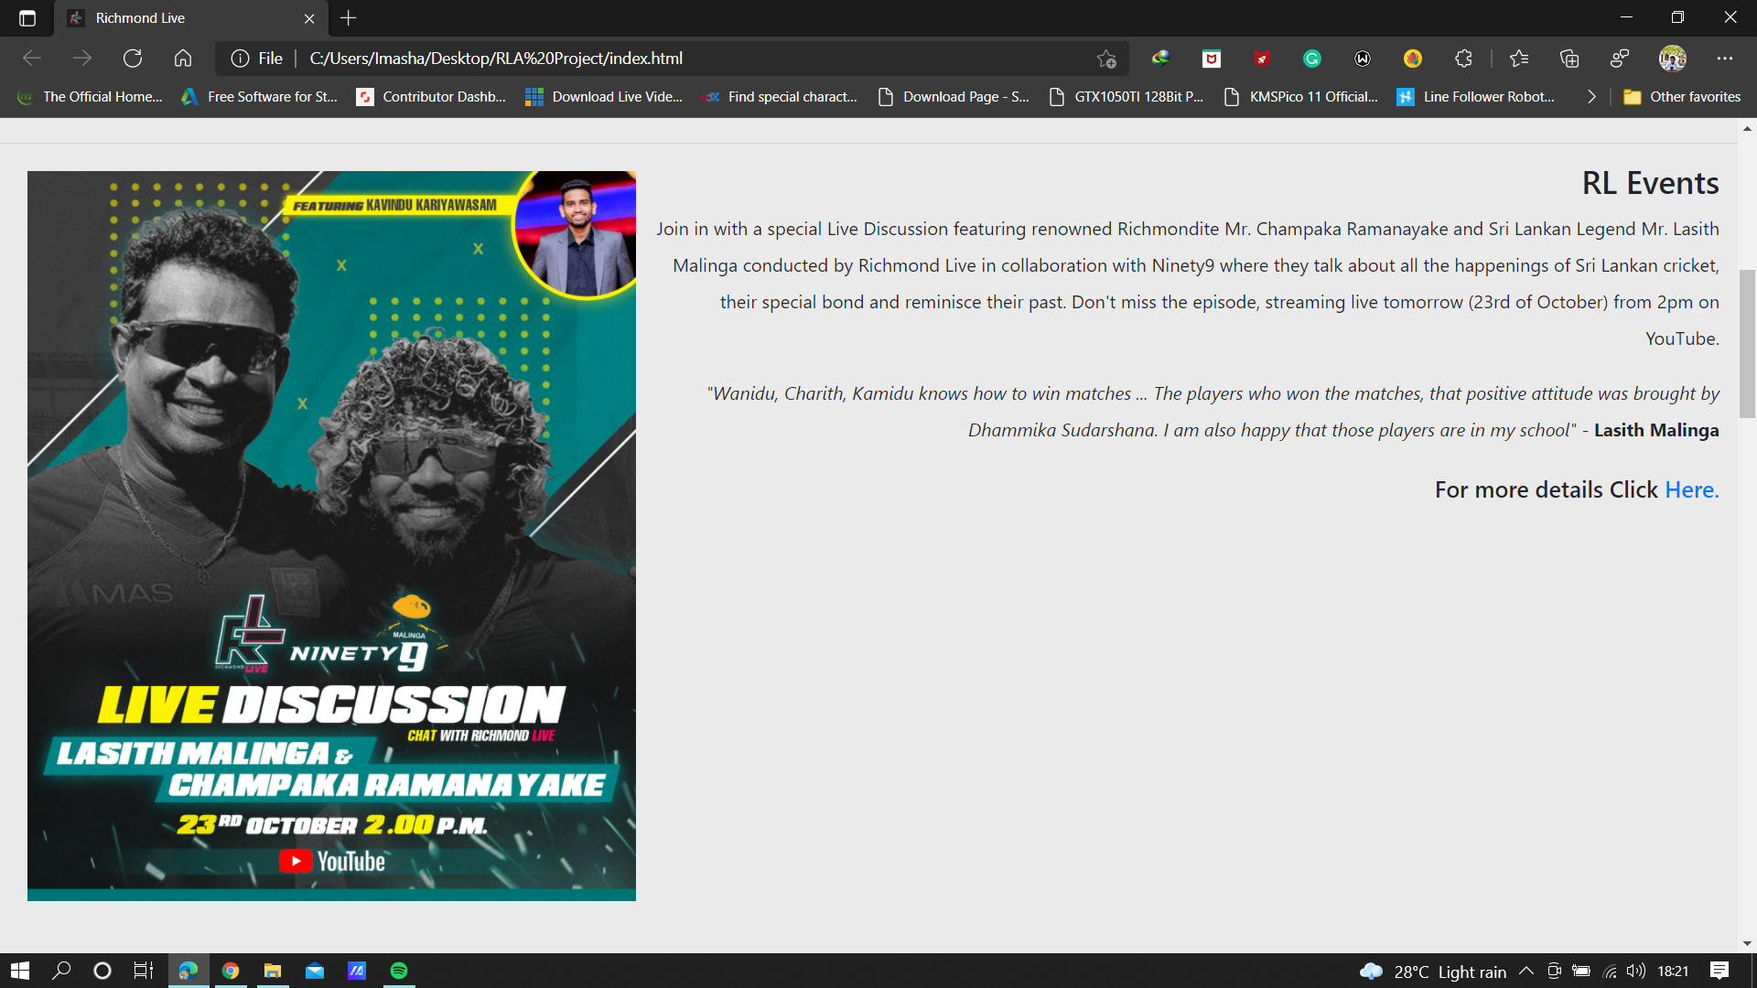
Home Page

Slide 5
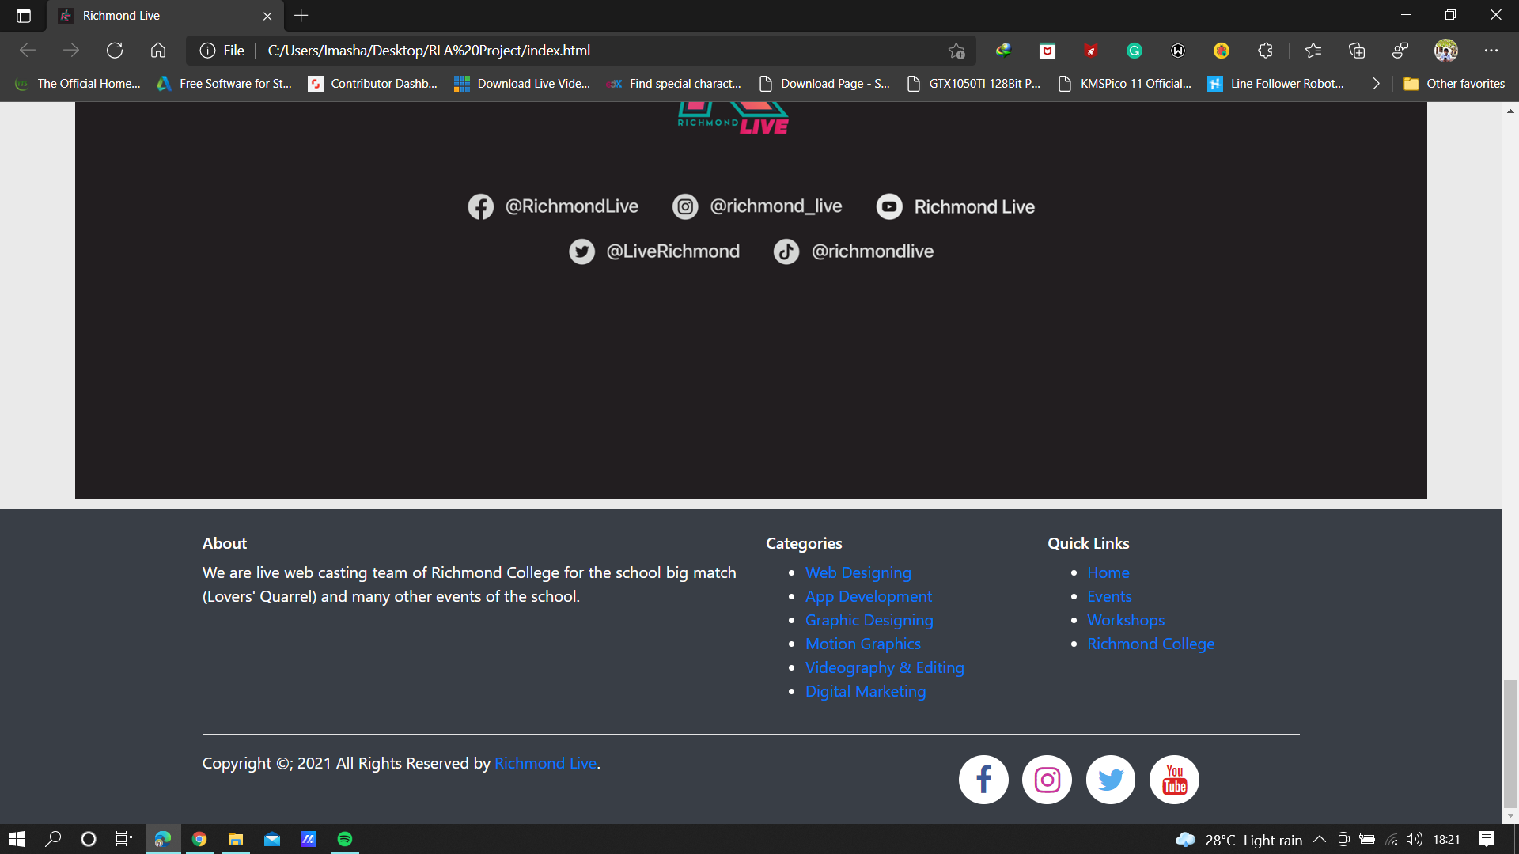

Slide 6
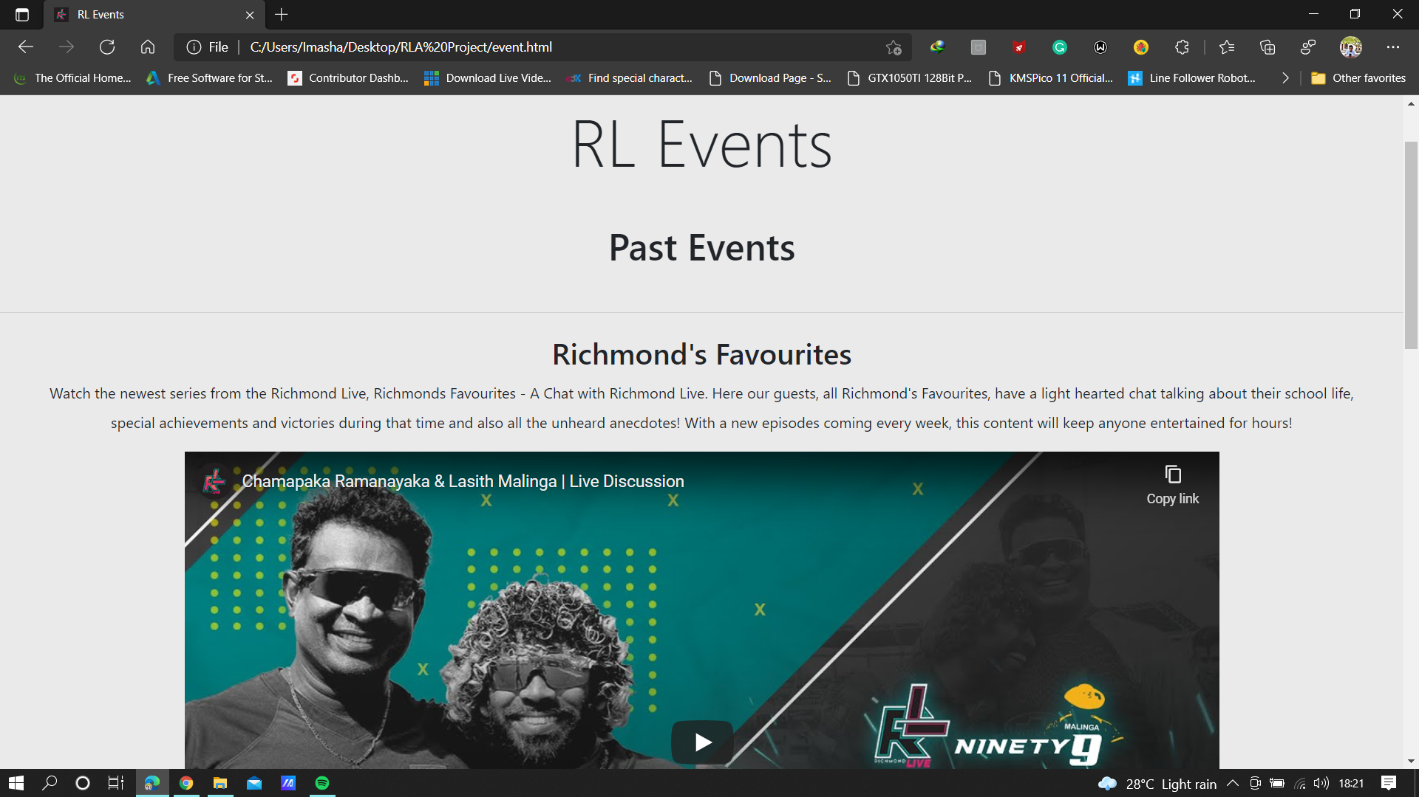
Event Page

Slide 7
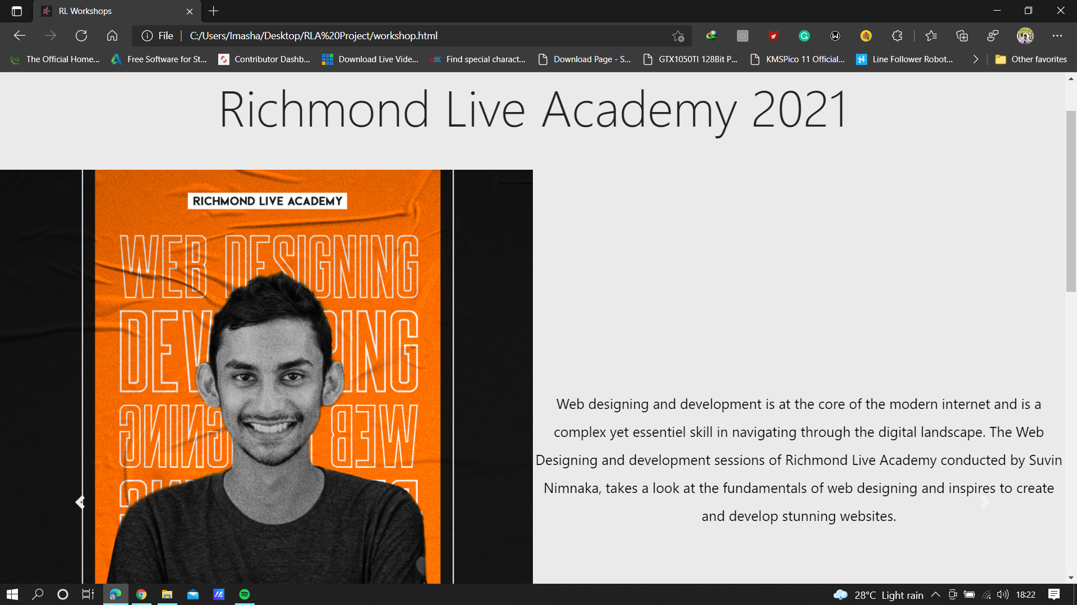
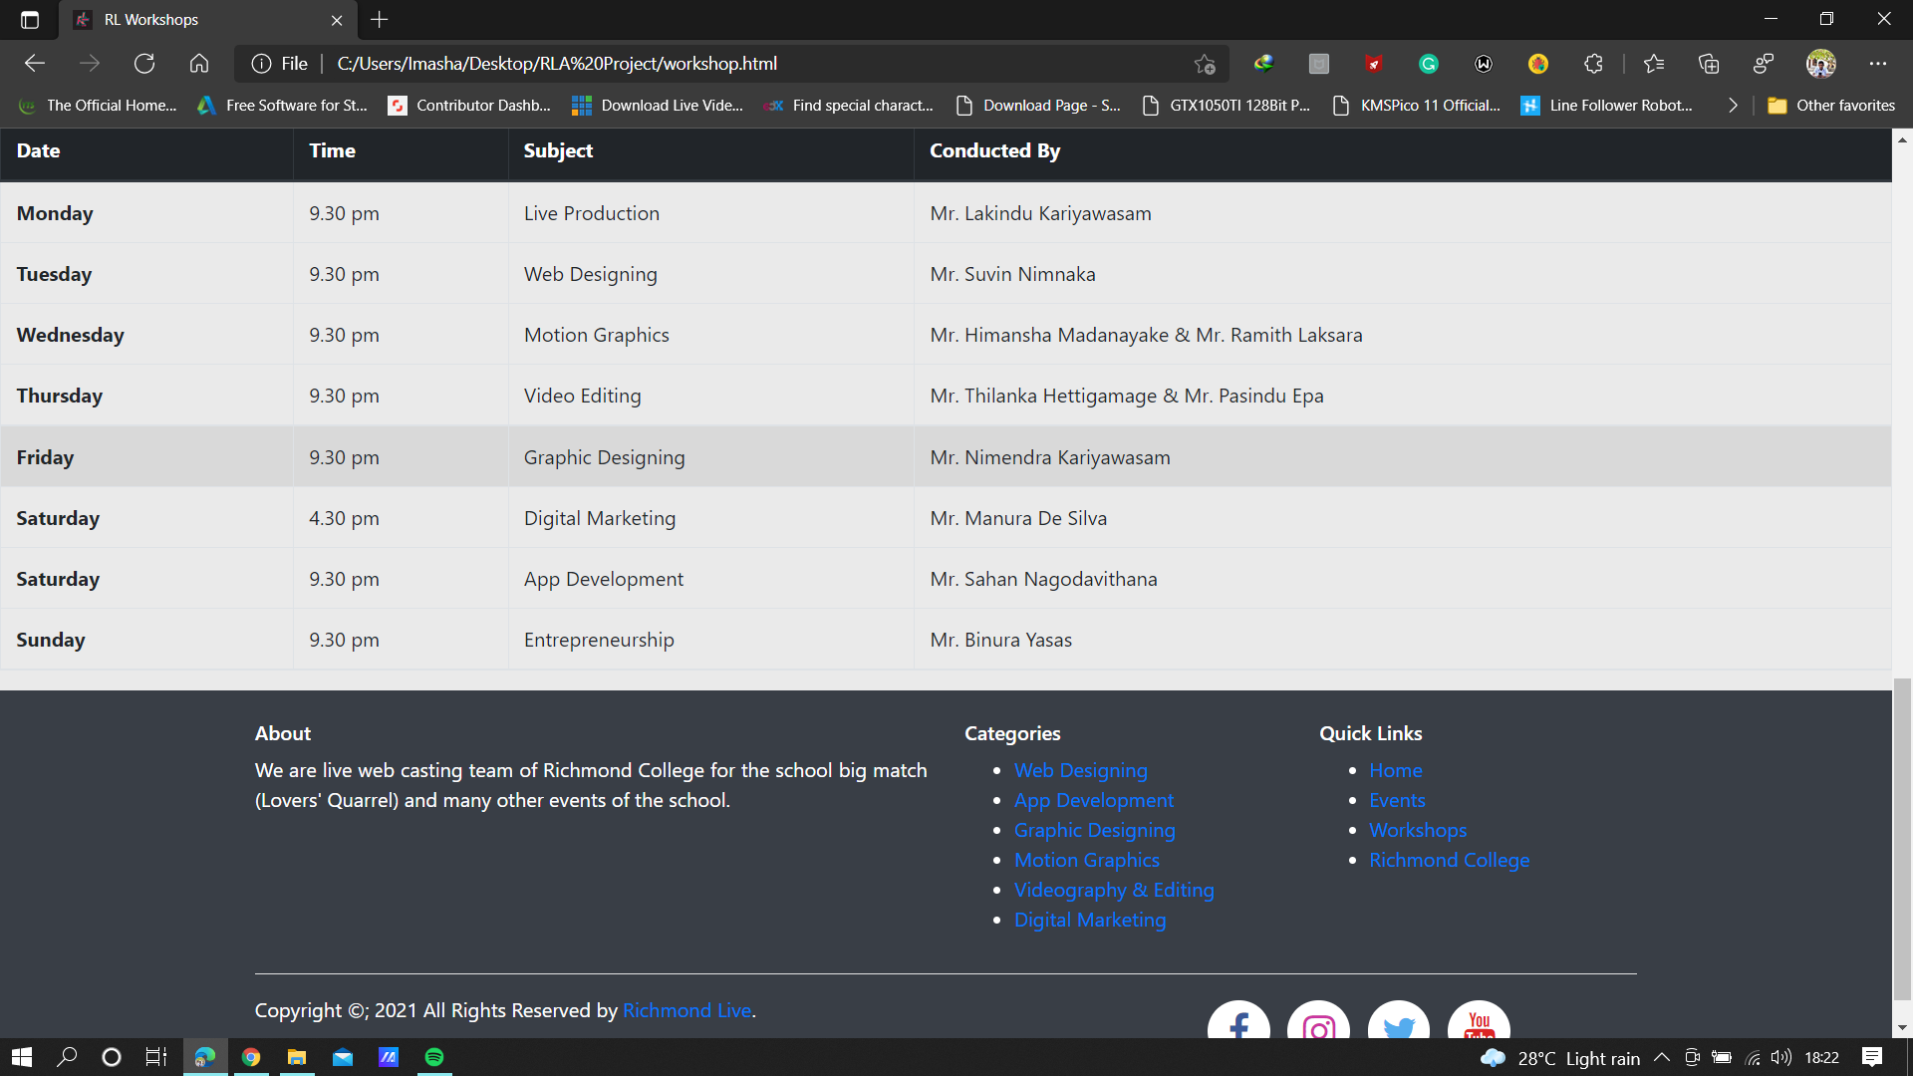
Workshop Page

Slide 8
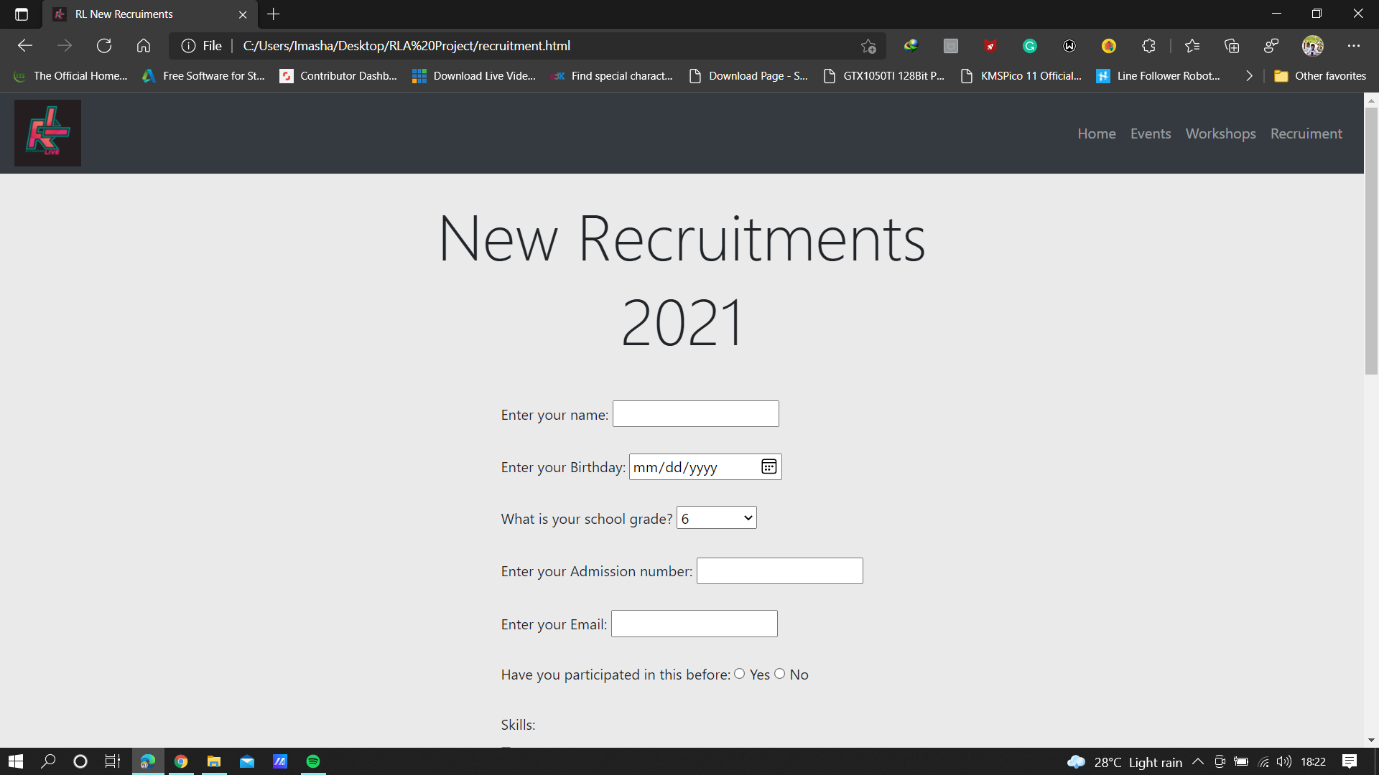
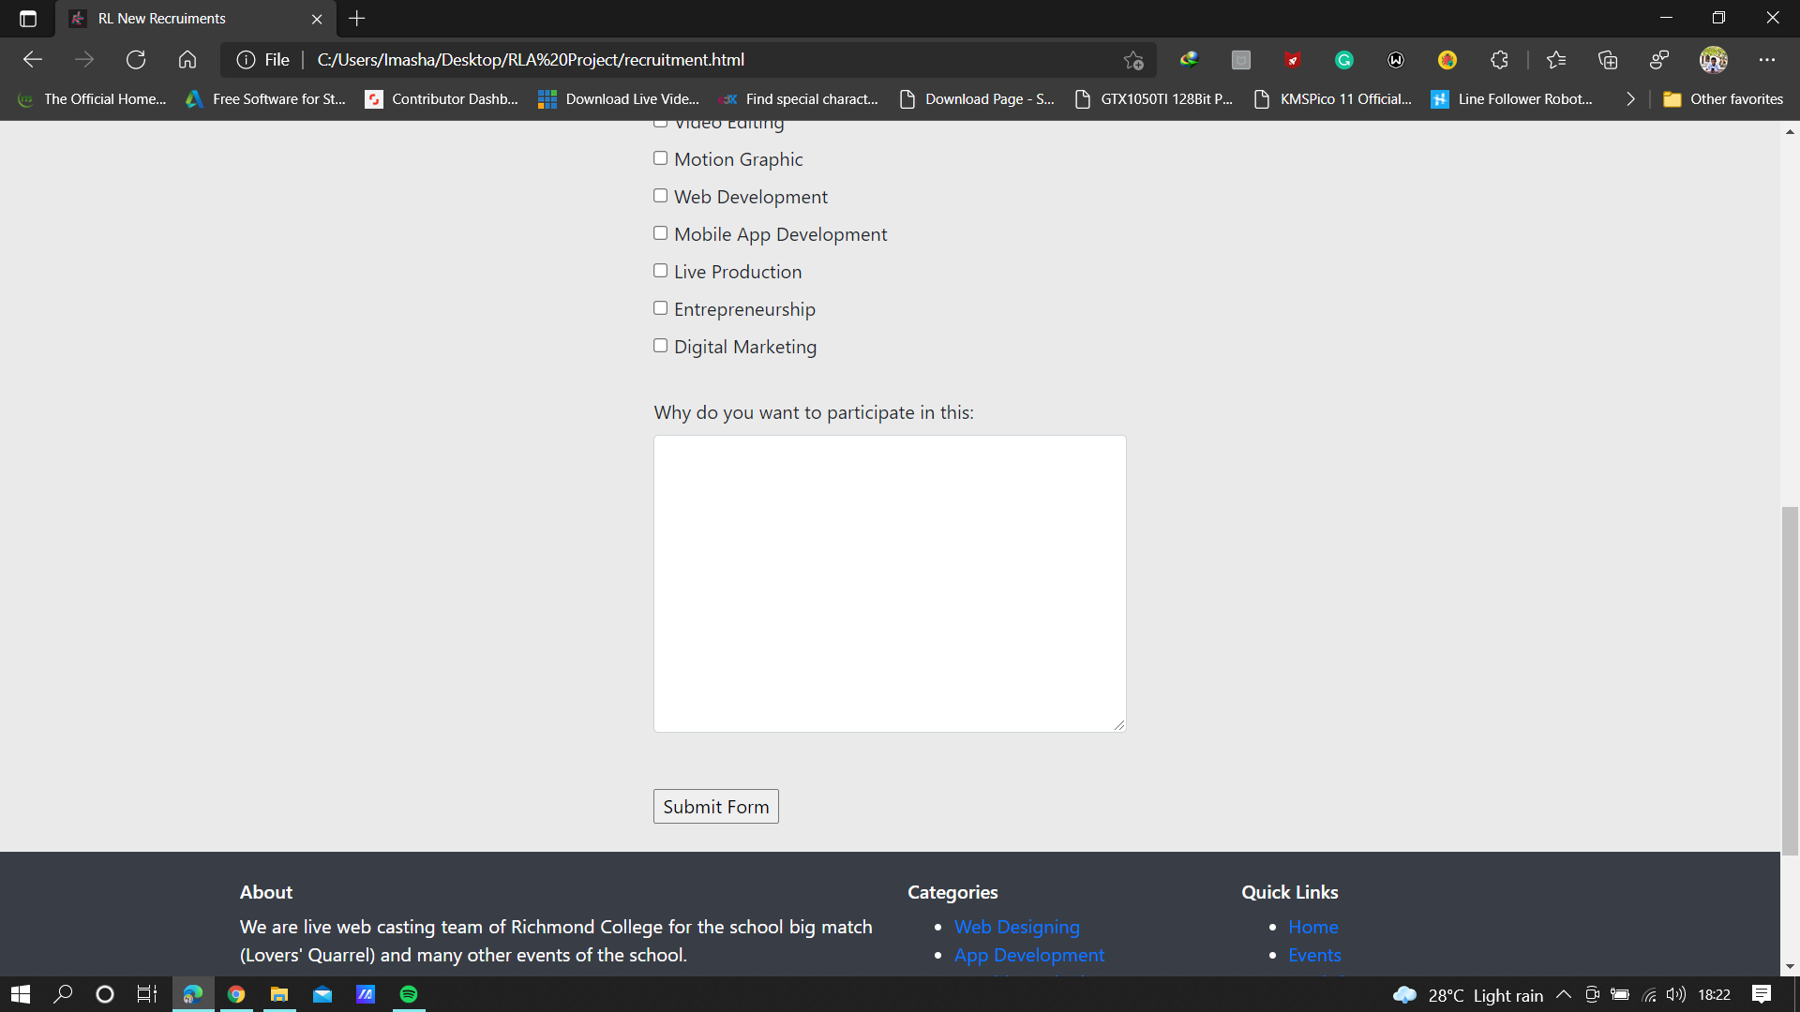
Recruiments Page

Slide 9
Mobile Responsive

Slide 11
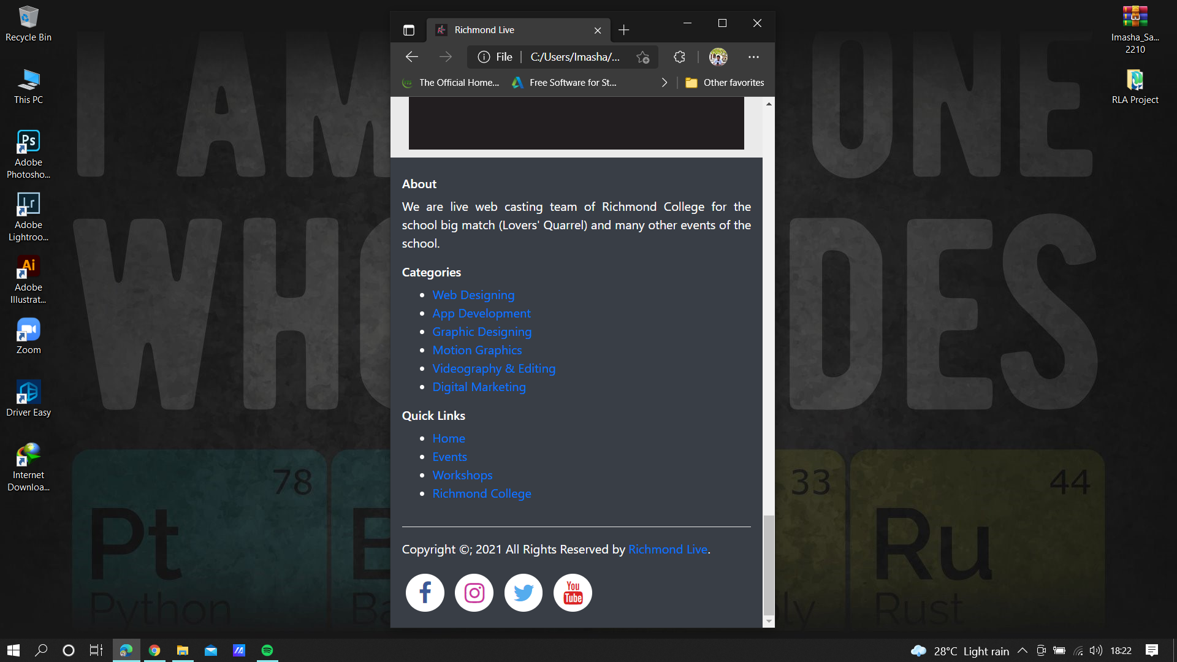
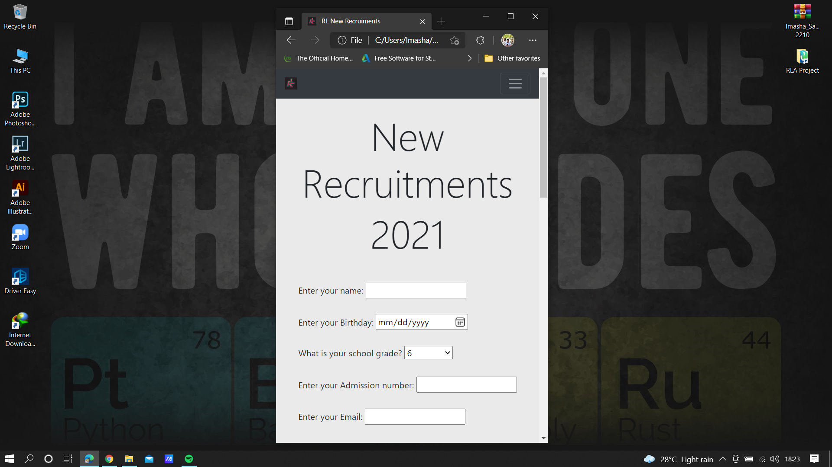

Slide 12
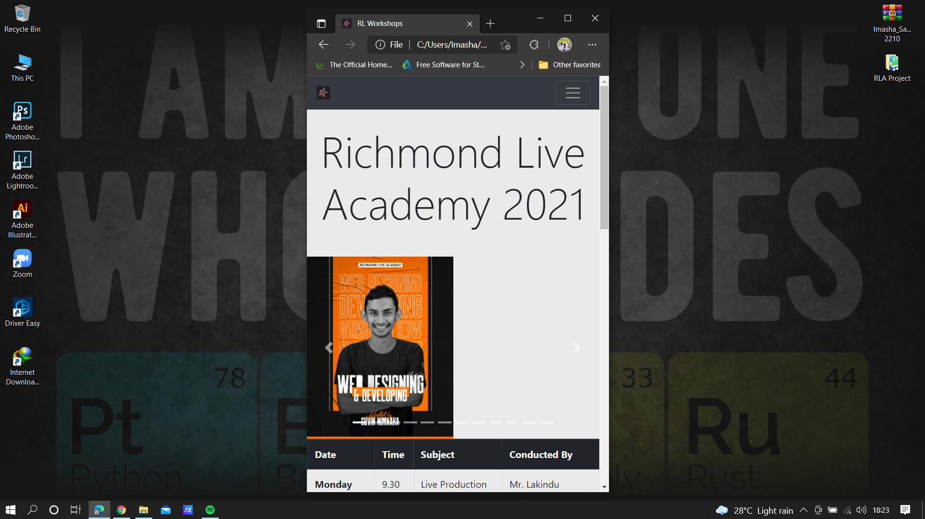
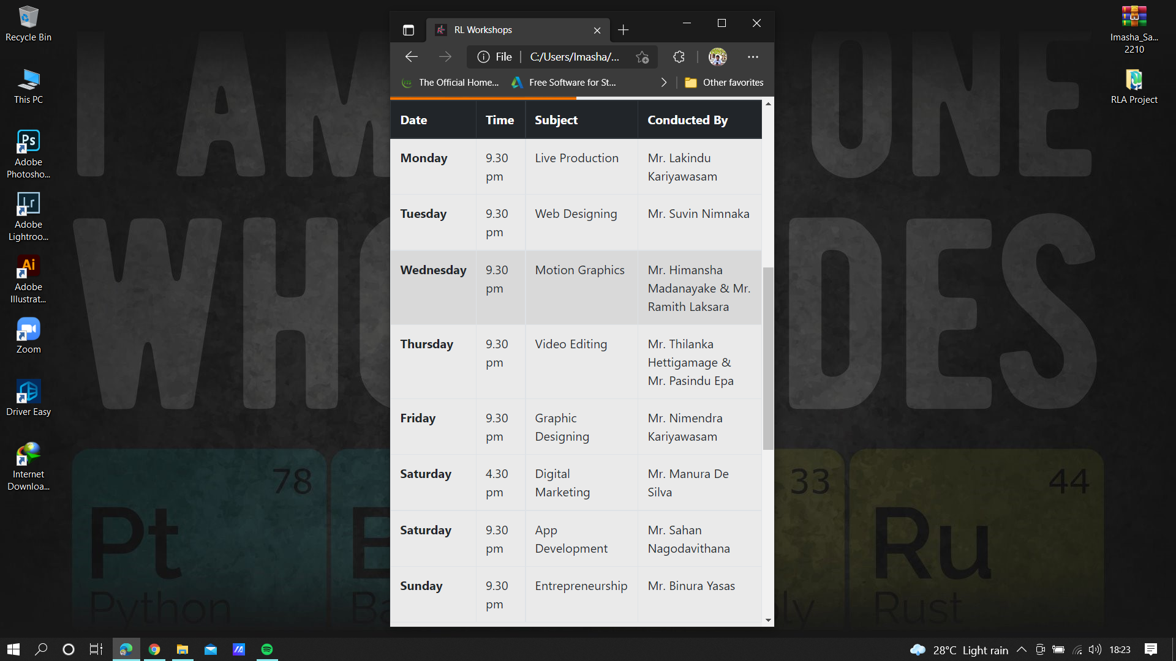

Slide 13
Thanks !!!

